Slide 1
on-Device nlp intelligence
Make iOS apps smarter
Muthu Venkatesh

Slide 2
About me
I’m Muthu Venkatesh
Born & Raised in Southern part of Tamil Nadu
Computer Science & Engineering graduate
Almost a decade of experience in Software Development
AI introduction course with IIT Madras through NPTEL(National Programme on Technology Enhanced Learning) initiative.

Slide 3
Agenda
What is Intelligence?
On-Device Processing - Edge AI
On-Device ML & NLP APIs in iOS
Custom NLP model Creation & Integration (Demo)
On-Device NLP model Prediction (Demo)
WWDC 2023 enhancements in NLP

Slide 4
Let’s talk about Intelligence
Notes:
If someone asks what is common between Tinder, TikTok, Netflix, and Google Maps? My answer would be- Machine Learning (ML) drives these apps.
Intelligence is moving towards edge devices. Increased computing power and sensor data along with improved AI algorithms are driving the trend towards machine learning be run on the end device, such as smartphones, watches, tv or automobiles, rather than in the cloud.

Slide 5
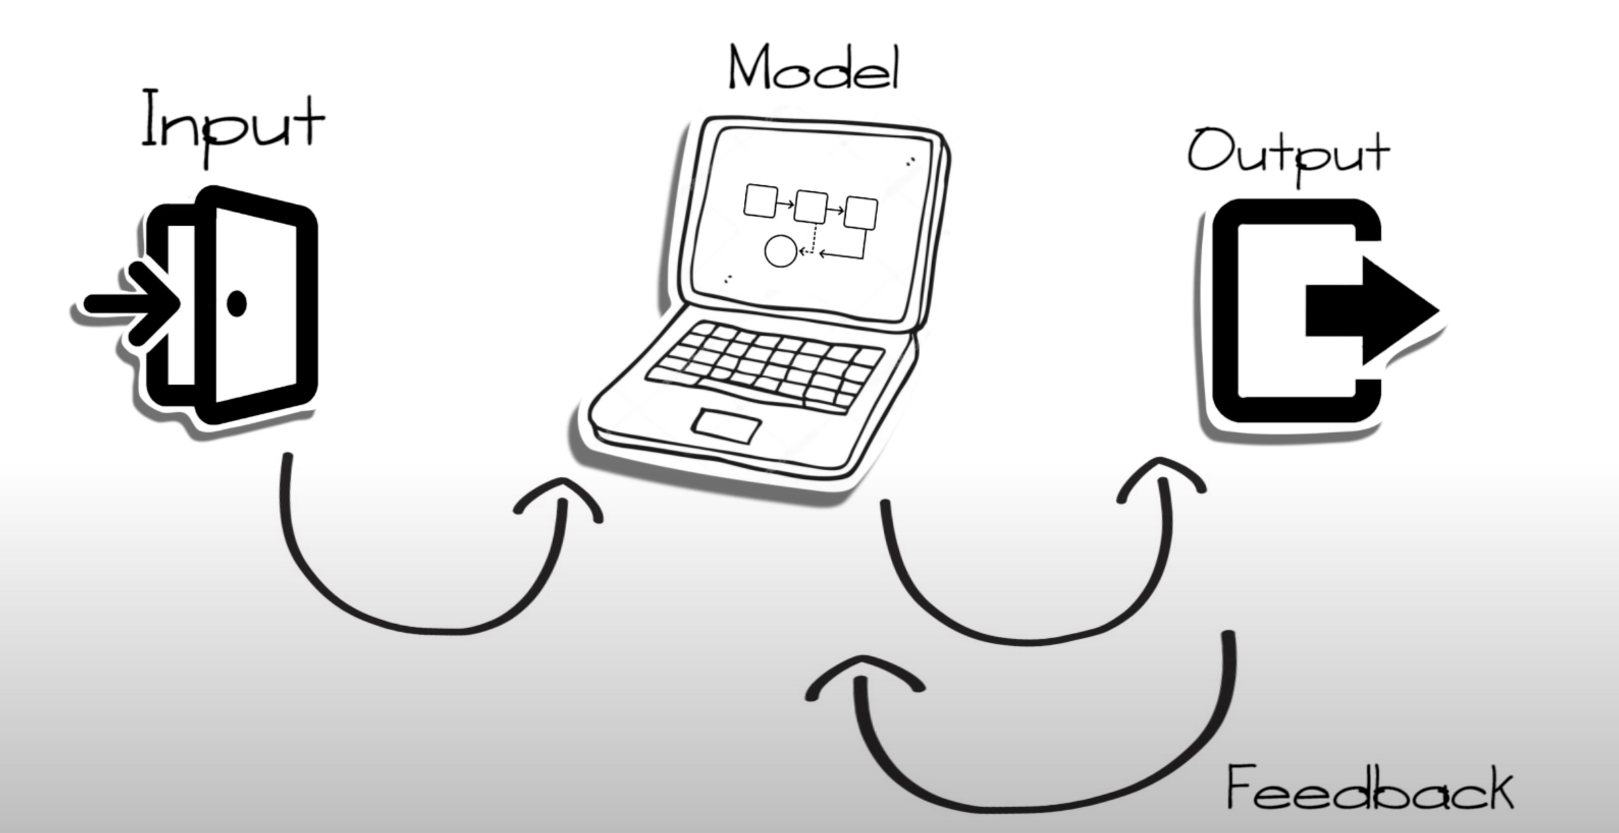
What is Machine learning?
Inputs feed the model
Model learns and generates outputs
Results of predictions can be applied to various objectives
Outputs can provide feedbacks to improve the predictions
Notes:
Humans learn from past experiences and machines follow instructions given by humans. But what if humans can train the machines to learn from past data and do what humans can do and much faster, well that’s called Machine Learning. But it's lot more than just learning, it’s also about understanding and reasoning.
First you have the inputs or the data, every device you use to generate data can be used for machine learning purposes. For eg) every search you do on the device or every move you do on a game, these are all inputs
Then the model is how we apply machine learning algorithms to the inputs, We use the models to make predictions based on the input data. For eg) you can train a model to detect specific objects within a photo directly from pixels
From these models we get the outputs, or results of the algorithms of the models. And this can be applied to hundreds of situations.
Finally from the outputs we can also provide feedbacks to the model in few specific algorithms which in turn can improve the predictions pace and quality out of the model

Slide 6
Why do it On-Device?
Private
Fast
Free
Notes:
Now that we understood what is machine learning and how it provides intelligent processing to applications, we need to know why we need it to be done on device?
What does this means?
This means running inference and generating predictions all happens on the user’s device and the three primary benefits to this are,
1) Private:
We do not need to send data anywhere for retraining. The user can be sure that their privacy is ensured. This is good for GDPR (General Data Protection Regulation) and other privacy concerns.
2) Fast:
There is no server latency and it also works offline which mean it can work on real-time video/audio input as well.
3) Free:
- We do not need to find and pay for a server as a developer.
No need for an Internet connection or mobile data cost as a user.
This led to the raise of On-Device Processing or Edge computing

Slide 7
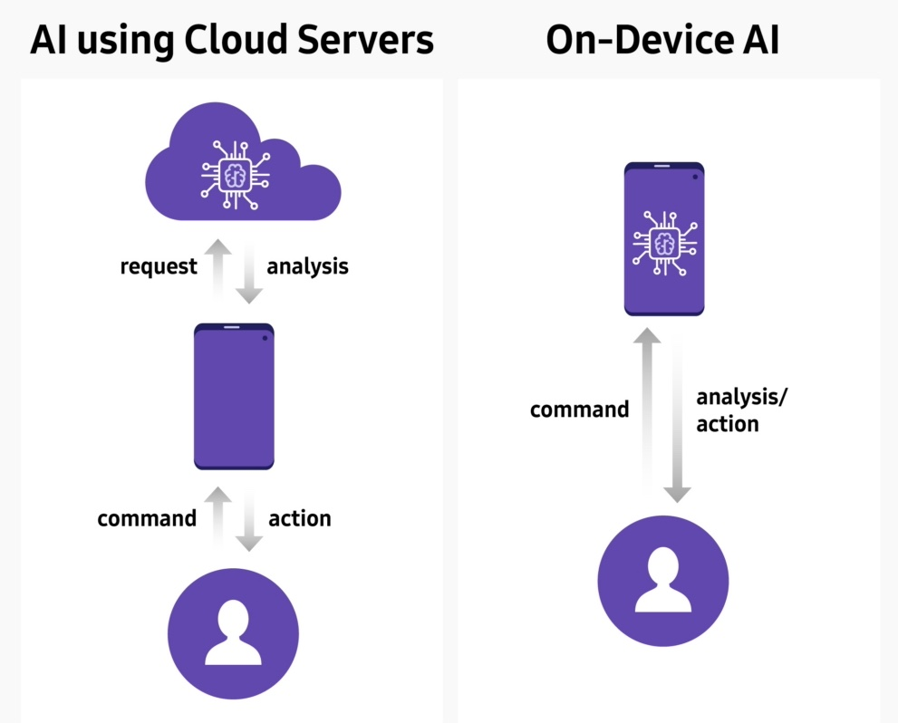
On-Device Processing (Edge AI)
One of the privacy pillars at Apple
Uses the processing power of the device rather than sending data to server.
Starting in iOS 15, speech processing are done on-device
Uses Apple Neural Engine
Health data usage
Notes:
Now Apple and Google say smartphones are smart enough to do some crucial and sensitive machine learning tasks like transcribing speech or suggesting message replies on their own.
On-Device processing is one of the privacy pillars at Apple. With increasing computational power of the device year after year we can utilise on device power instead of sending data to the server
Can take advantage of the On-Device neural engine processing where in few of the computational algorithms perform better over CPUs and GPUs
An example of On-Device processing can be Siri, How it processes requests offline without sending any request out of the device. Now Siri can transcribe speech without tapping the cloud in some languages on recent and future iPhones and iPads

Slide 8
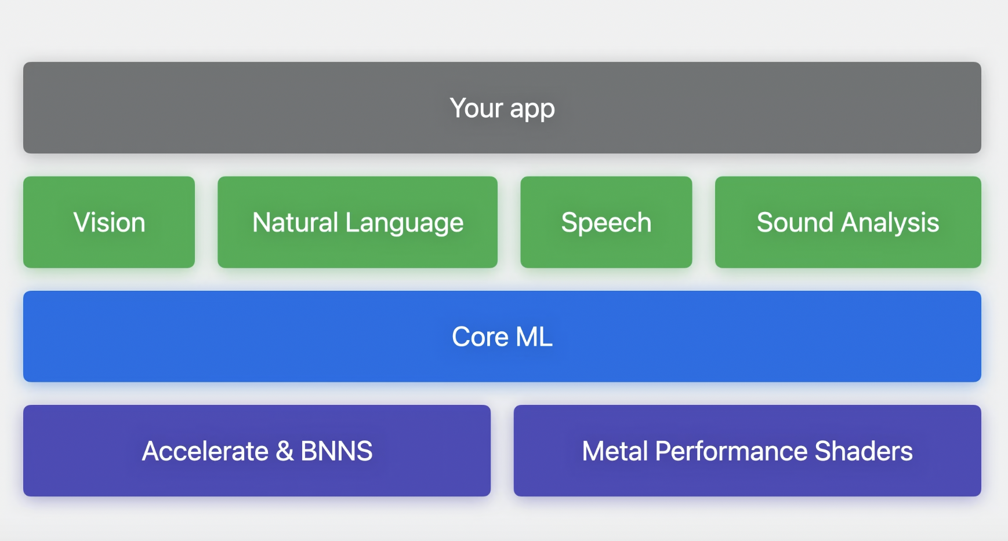
On-Device Intelligence APIs
Notes:
https://developer.apple.com/machine-learning/api/
Accelerate library has collection of function that helps you use to construct neural networks for training and inference running on low energy consumption for CPUs
Metal Performance Shaders - Optimize graphics and compute performance with kernels that are fine-tuned for the unique characteristics of each Metal GPU family.
Vision
Apply computer vision algorithms to perform a variety of tasks on input images and video.
Eg) face and face landmark detection, text detection, barcode recognition, image registration, and general feature tracking.
VNClassifyImageRequest, VNDetectHumanRectanglesRequest, VNDetectTrajectoriesRequest, VNDetectHumanHandPoseRequest
Natural Language
Analyse natural language text and deduce its language-specific metadata.
Provides a variety of natural language processing (NLP) functionality with support for many different languages and scripts.
Eg) segment natural language text into paragraphs, sentences, or words, and tag information about those segments, such as part of speech, lexical class, lemma, script, and language. You can also use this framework with Create ML to train and deploy custom natural language models.
NLLanguageRecognizer
Speech
Perform speech recognition on live or prerecorded audio, receive transcriptions, alternative interpretations, and confidence levels of the results.
SFSpeechRecognizer
Sound Analysis
Classify various sounds by analysing audio files or streams.
Identify specific sounds, such as laughter or applause, in your app by creating an SNClassifySoundRequest to analyze an audio file or stream.
Sound requests can identify over 300 sounds. Alternatively, you identify a custom set of sounds by providing the sound request with a custom Core ML model.
SNAudioStreamAnalyzer, SNSoundClassificationRequest

Slide 9
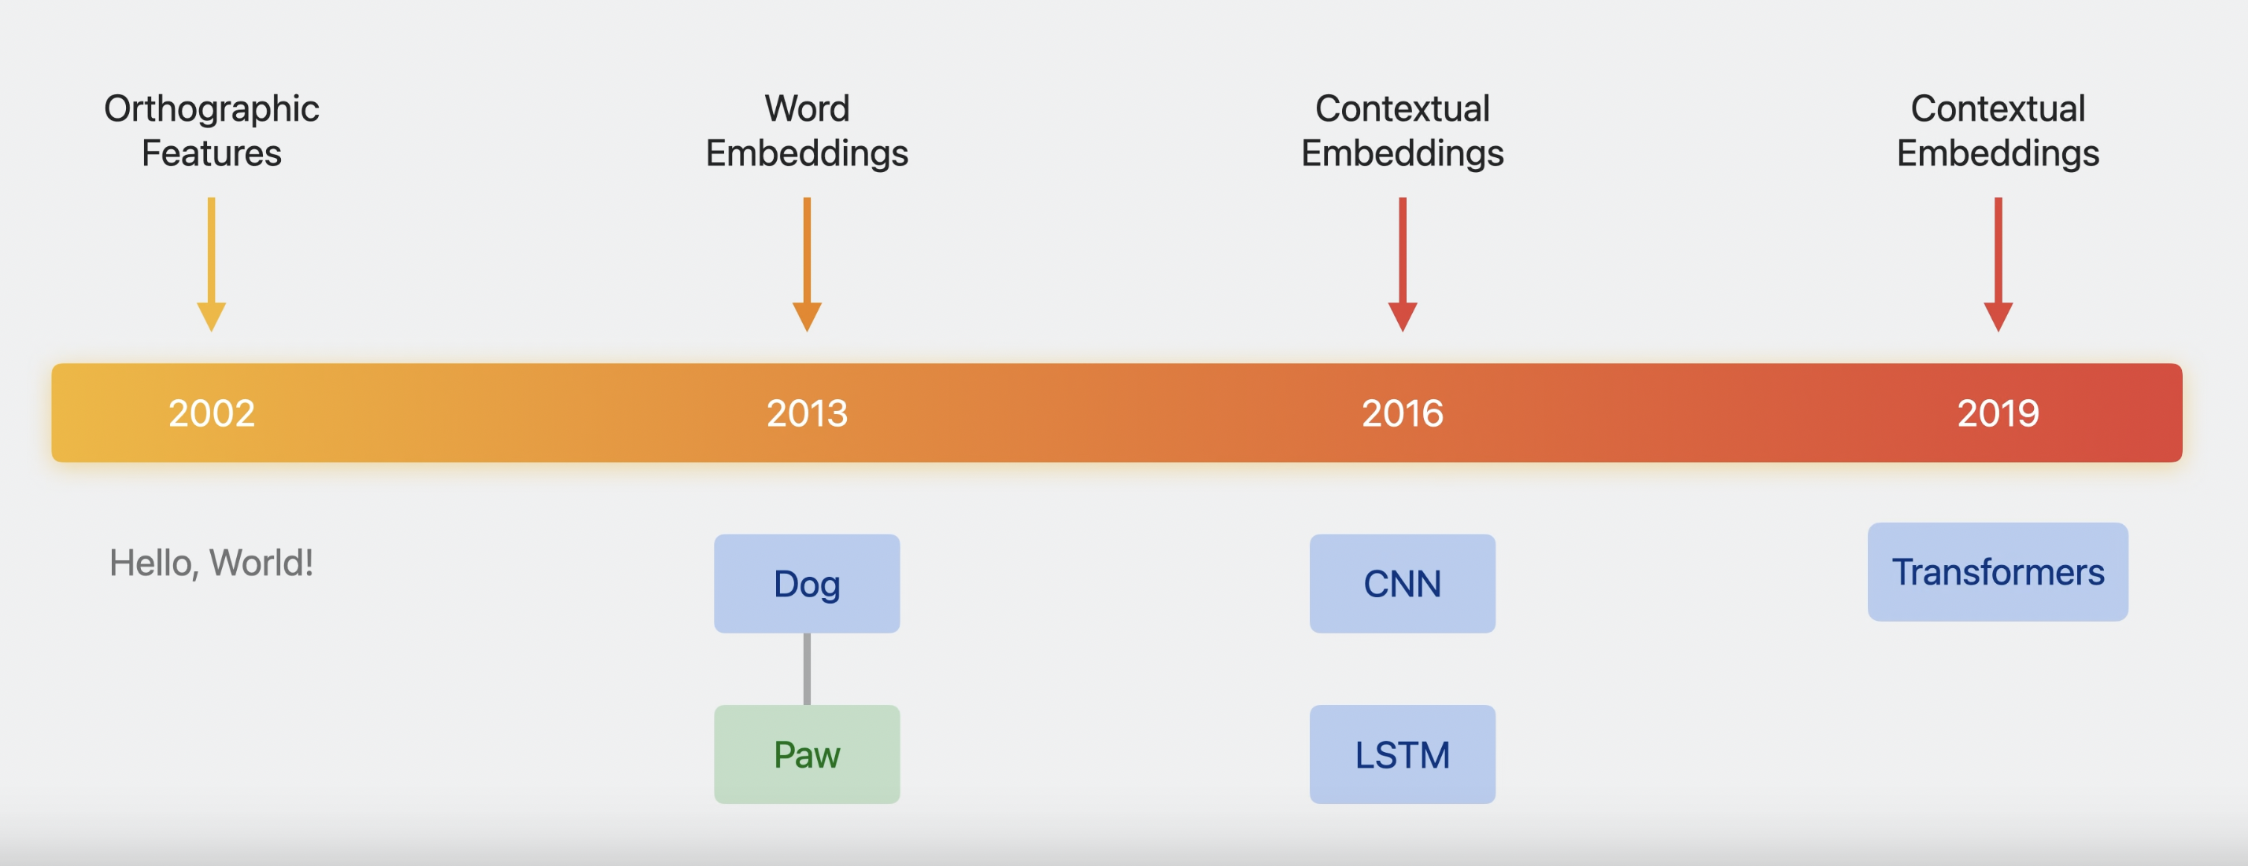
Evolution of NLP Models
Notes:
Natural language processing (NLP) refers to the branch of computer science—and more specifically, the branch of artificial intelligence or AI—concerned with giving computers the ability to understand text and spoken words in much the same way human beings can.
NLP combines computational linguistics—rule-based modeling of human language—with statistical, machine learning, and deep learning models. Together, these technologies enable computers to process human language in the form of text or voice data and to translates concepts into symbols and also contents into concepts
Evolution can be traced as increasing sophistication of input layers.
20 yeas ago it was simply orthographic features
Decade ago things moved to Static word embedding such as Word2Vec and GloVe
Then came contextual sentence embeddings based on Neural network models such as CNNs and LSTMs
Recently Transformers based Language models
CNN - Convolutional Neural networks
LSTM- Long-Short term Memory, efficiently improves performance by memorising relevant information that is important and finding pattern
Transformers - As opposed to directional models, which read the text input sequentially (left-to-right or right-to-left), the Transformer encoder reads the entire sequence of words at once. Therefore it is considered bidirectional, though it would be more accurate to say that it’s non-directional. This characteristic allows the model to learn the context of a word based on all of its surroundings (left and right of the word).
I should say a few words about embeddings.

Slide 10
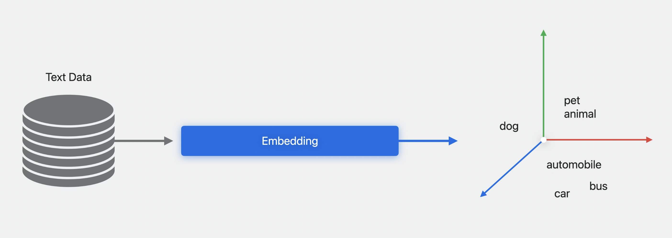
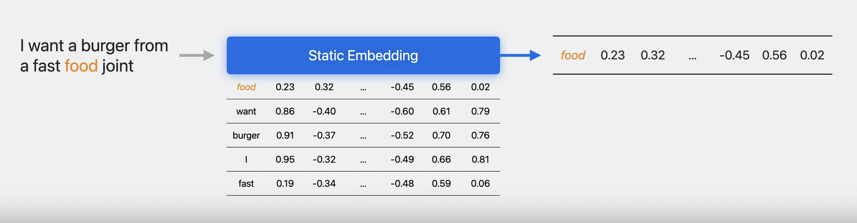
NLP Embeddings
Notes:
Embeddings have played a crucial role in the evolution of natural language processing (NLP) techniques, with newer methods offering significant improvements in capturing semantic meaning. Here are several key pointers outlining the evolution of embeddings in NLP:
In the simplest form it’s just a map from words in a language to vectors in some abstract vector space but trained a ML model such that words with similar meaning are close together in vector space. This allows it to incorporate linguistic knowledge
In Static Embedding, pass in a word the model looks it up in a table and provides a vector. These are trained in such a way that words with similar meaning are close together in vector space as can be seen from the table here.
Static Embedding is quiet useful for understanding individual words
1. One-Hot Encoding:
This is the simplest method to create word vectors, where each word is represented as a binary vector with one element set to 1, corresponding to the word's index, and the rest set to 0.
2. Count-Based Methods (Co-occurrence Matrix):
Co-occurrence matrix-based methods, such as Latent Semantic Analysis (LSA), use the frequency counts of words appearing together in a fixed-size context window. These methods generate an intermediate high-dimensional representation and employ dimensionality reduction techniques like Singular Value Decomposition (SVD) to reduce the matrix dimension.
3. Prediction-Based Methods (Neural Embeddings):
These methods employ neural networks to learn word vectors. Notable examples are Word2Vec and GloVe. Word2Vec has two primary models: Continuous Bag of Words (CBOW) and Skip-Gram. The CBOW model predicts the center word based on context words, whereas the Skip-Gram model predicts context words based on the center word. GloVe, on the other hand, is a hybrid solution that combines the statistical and neural approaches, taking advantage of global corpus statistics and local context.
4. Subword Embeddings (FastText):
Introduced by Facebook's AI Research lab, FastText improves upon Word2Vec by incorporating subword information. The technique takes into account the internal structure of words, learning embeddings for smaller character n-grams and constructing the word representation based on its constituent n-grams. This allows for better handling of out-of-vocabulary words, morphological variations, and rare words.
5. Contextual Word Embeddings (ELMo, BERT):
Contextual embeddings consider the context in which the word appears, addressing the limitation of fixed embeddings that ignore the context. ELMo (Embeddings from Language Models) computes word representations by incorporating information from the entire input sentence using a bidirectional LSTM-based model. BERT (Bidirectional Encoder Representations from Transformers) builds upon the Transformer architecture, introducing masked language modeling and next sentence prediction tasks. BERT embeddings capture both left and right context, enabling better handling of polysemy and complex language understanding.
6. Pretrained Language Models (GPT, RoBERTa):
Language models like GPT (Generative Pre-trained Transformer) and RoBERTa further extend the advancements made by BERT. While BERT is designed as a bidirectional model, GPT is a unidirectional architecture that leverages the Transformer model for various NLP tasks. RoBERTa is an optimized variant of BERT, using larger input sequences, bigger batches, and multiple masked tokens for training.
The evolution of embeddings in NLP has advanced significantly over the years, from one-hot encoding to complex, contextual embeddings based on deep learning techniques. Modern embeddings, such as BERT and GPT, help NLP models achieve state-of-the-art performance in various tasks, from sentiment analysis and text classification to question-answering and machine translation.

Slide 11
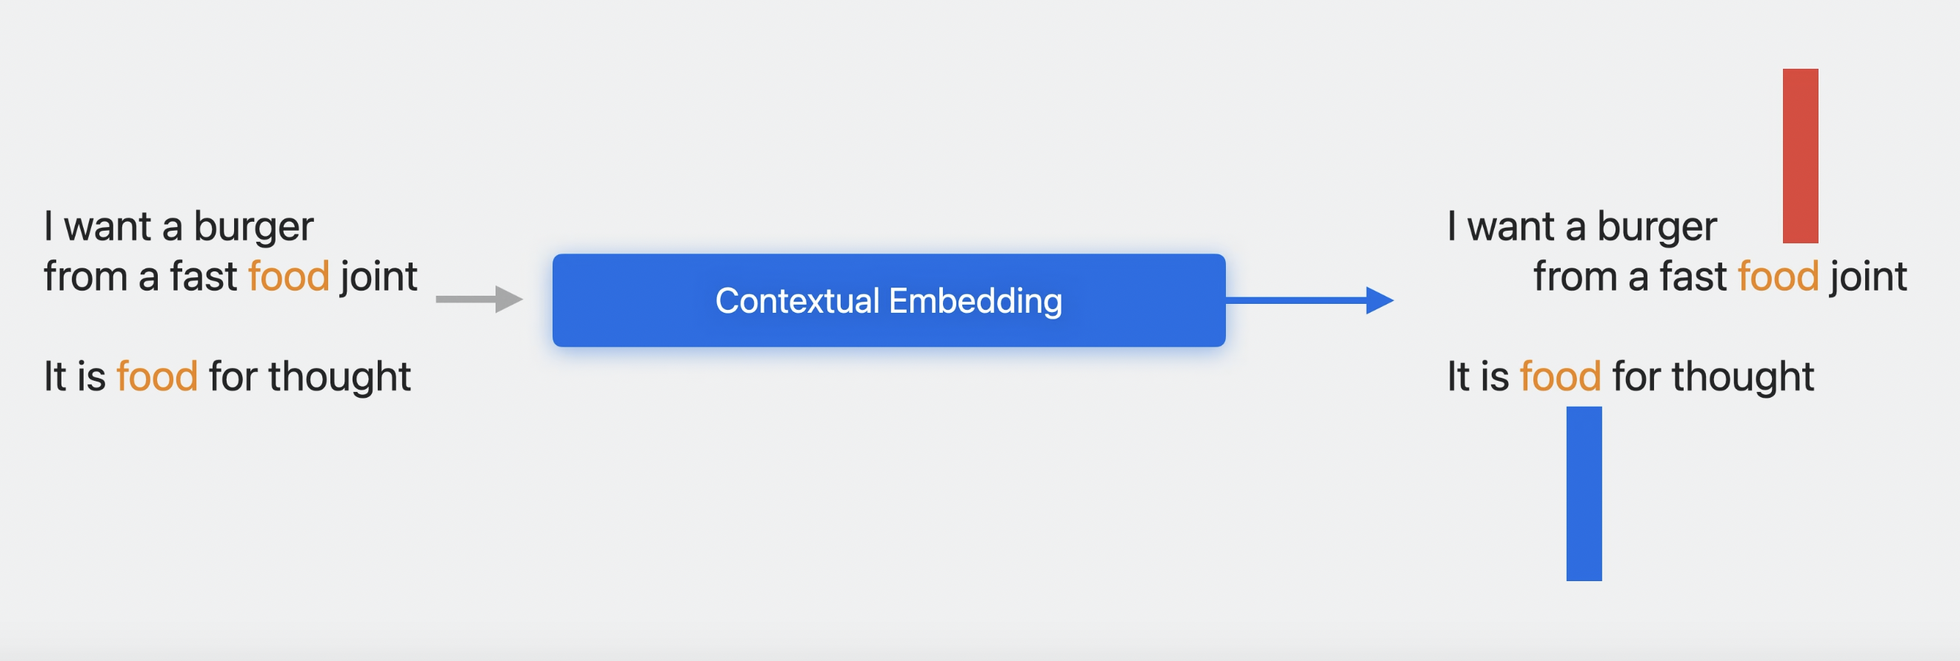
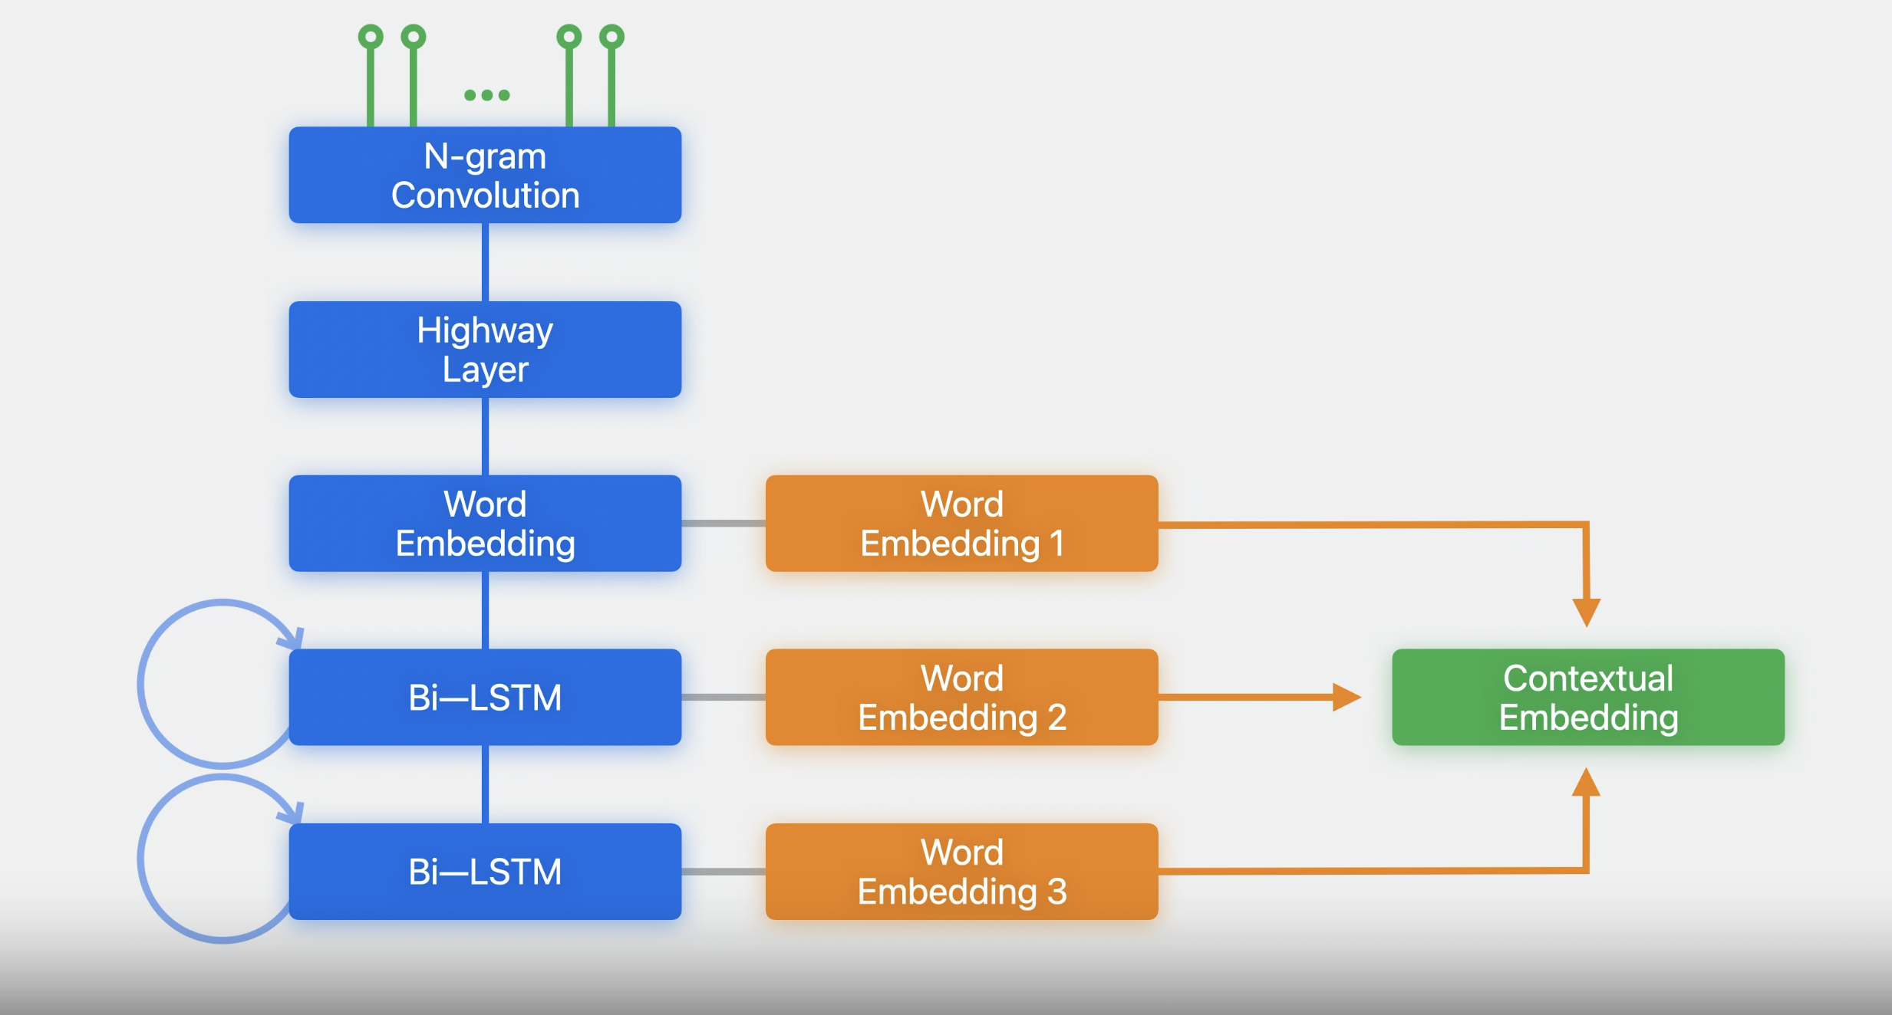
Contextual Embeddings
ELMo Model
Notes:
More sophisticated embeddings are more dynamic & contextual such that each word in a sentence is mapped to a different vector depending on it’s use in the sentence like the example here food in fast food has different meaning that food for thought
The point for having a powerful embedding as input layer is to enable transfer learning, The embedding models are trained on a vast amount of training data and has good inference on the language. This knowledge can be transferred to a specific task without requiring huge amounts of task specific training data
Embeddings have played a crucial role in the evolution of natural language processing (NLP) techniques, with newer methods offering significant improvements in capturing semantic meaning. Here are several key pointers outlining the evolution of embeddings in NLP:
1. One-Hot Encoding:
This is the simplest method to create word vectors, where each word is represented as a binary vector with one element set to 1, corresponding to the word's index, and the rest set to 0.
2. Count-Based Methods (Co-occurrence Matrix):
Co-occurrence matrix-based methods, such as Latent Semantic Analysis (LSA), use the frequency counts of words appearing together in a fixed-size context window. These methods generate an intermediate high-dimensional representation and employ dimensionality reduction techniques like Singular Value Decomposition (SVD) to reduce the matrix dimension.
3. Prediction-Based Methods (Neural Embeddings):
These methods employ neural networks to learn word vectors. Notable examples are Word2Vec and GloVe. Word2Vec has two primary models: Continuous Bag of Words (CBOW) and Skip-Gram. The CBOW model predicts the center word based on context words, whereas the Skip-Gram model predicts context words based on the center word. GloVe, on the other hand, is a hybrid solution that combines the statistical and neural approaches, taking advantage of global corpus statistics and local context.
4. Subword Embeddings (FastText):
Introduced by Facebook's AI Research lab, FastText improves upon Word2Vec by incorporating subword information. The technique takes into account the internal structure of words, learning embeddings for smaller character n-grams and constructing the word representation based on its constituent n-grams. This allows for better handling of out-of-vocabulary words, morphological variations, and rare words.
5. Contextual Word Embeddings (ELMo, BERT):
Contextual embeddings consider the context in which the word appears, addressing the limitation of fixed embeddings that ignore the context. ELMo (Embeddings from Language Models) computes word representations by incorporating information from the entire input sentence using a bidirectional LSTM-based model. BERT (Bidirectional Encoder Representations from Transformers) builds upon the Transformer architecture, introducing masked language modeling and next sentence prediction tasks. BERT embeddings capture both left and right context, enabling better handling of polysemy and complex language understanding.
6. Pretrained Language Models (GPT, RoBERTa):
Language models like GPT (Generative Pre-trained Transformer) and RoBERTa further extend the advancements made by BERT. While BERT is designed as a bidirectional model, GPT is a unidirectional architecture that leverages the Transformer model for various NLP tasks. RoBERTa is an optimized variant of BERT, using larger input sequences, bigger batches, and multiple masked tokens for training.
The evolution of embeddings in NLP has advanced significantly over the years, from one-hot encoding to complex, contextual embeddings based on deep learning techniques. Modern embeddings, such as BERT and GPT, help NLP models achieve state-of-the-art performance in various tasks, from sentiment analysis and text classification to question-answering and machine translation.

Slide 12
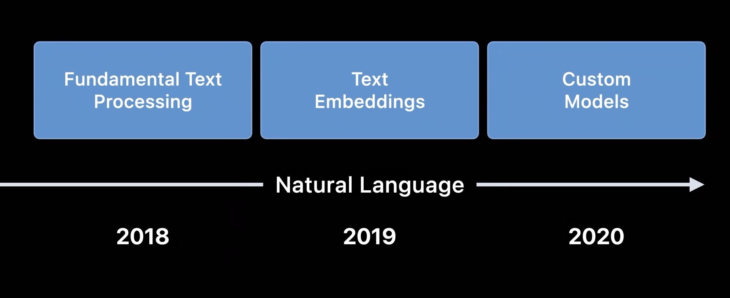
On-Device NLP in iOS
Notes:
2017 NSLinguisticTagger class in Foundation framework and it is deprecated
2018 NaturalLanguage Framework, started focusing of modern NLP techniques like Text Embeddings and custom model
Along with that they started integrating NLP with Apple’s machine learning ecosystem using CoreML and CreateML

Slide 13
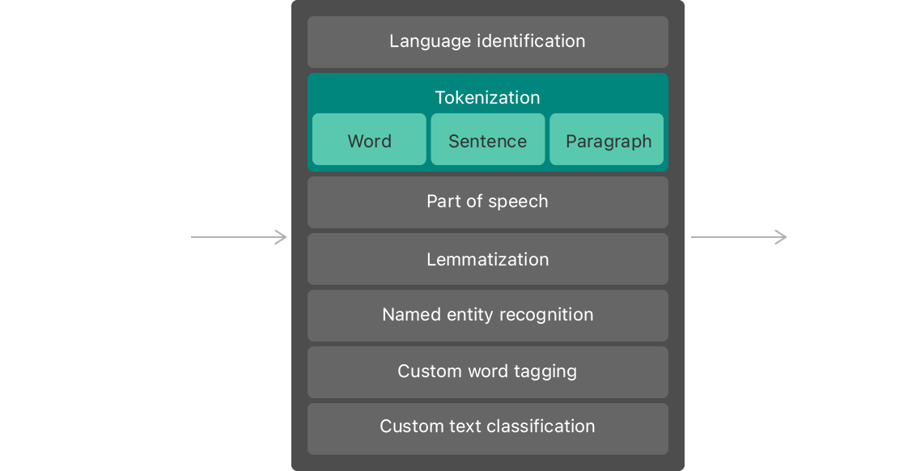
Fundamental Text Processing APIs
Word Tagging - To extract piece of information from unstructured texts
UseCases:
Text Summarisation
Keyword Extraction
Text-to-Speech, Speech-to-Text
Named Entities from Text
On-Device Language detection & translation
Spell checking & Autocorrection
Notes:
Use this framework to perform tasks like:
- Language identification, automatically detecting the language of a piece of text.
- Tokenization, breaking up a piece of text into linguistic units or tokens.
- Parts-of-speech tagging, marking up individual words with their part of speech.
- Lemmatization, deducing a word's stem based on its morphological analysis.
Named entity recognition, identifying tokens as names of people, places, or organizations.
Text Summarization: Generate concise summaries of a text by extracting the most important sentences or phrases using NLP techniques and pre-trained models. This enables users to glean the main points of a long article or document quickly.
Keyword Extraction: Extract the most relevant and essential words or phrases from a text, which can be used for indexing content, creating tag clouds, or summarizing documents.
Text-to-Speech (TTS) and Speech-to-Text (STT): Use the Speech and AVFoundation frameworks to convert text to spoken words or transcribe spoken words into text, enabling voice-driven interactions and accessibility features in your app.
Named Entity Recognition (NER): Detect and tag named entities like names, locations, organizations, dates, or other categories in the text. This can be used for searching, filtering, or extracting relevant data from unstructured text sources.
Spell Checking and Autocorrect: Implement text checking and correction functionality in your app, which can be done using the UITextChecker class in iOS. This helps users avoid making mistakes while typing or submitting text.

Slide 14
Text Embedding APIs
Embedding - Text data in a continuous vector space
UseCases:
Text Classification
Text Generation
Information Retrieval
Sentiment Analysis
Semantic Search & Query Expansion

Slide 15
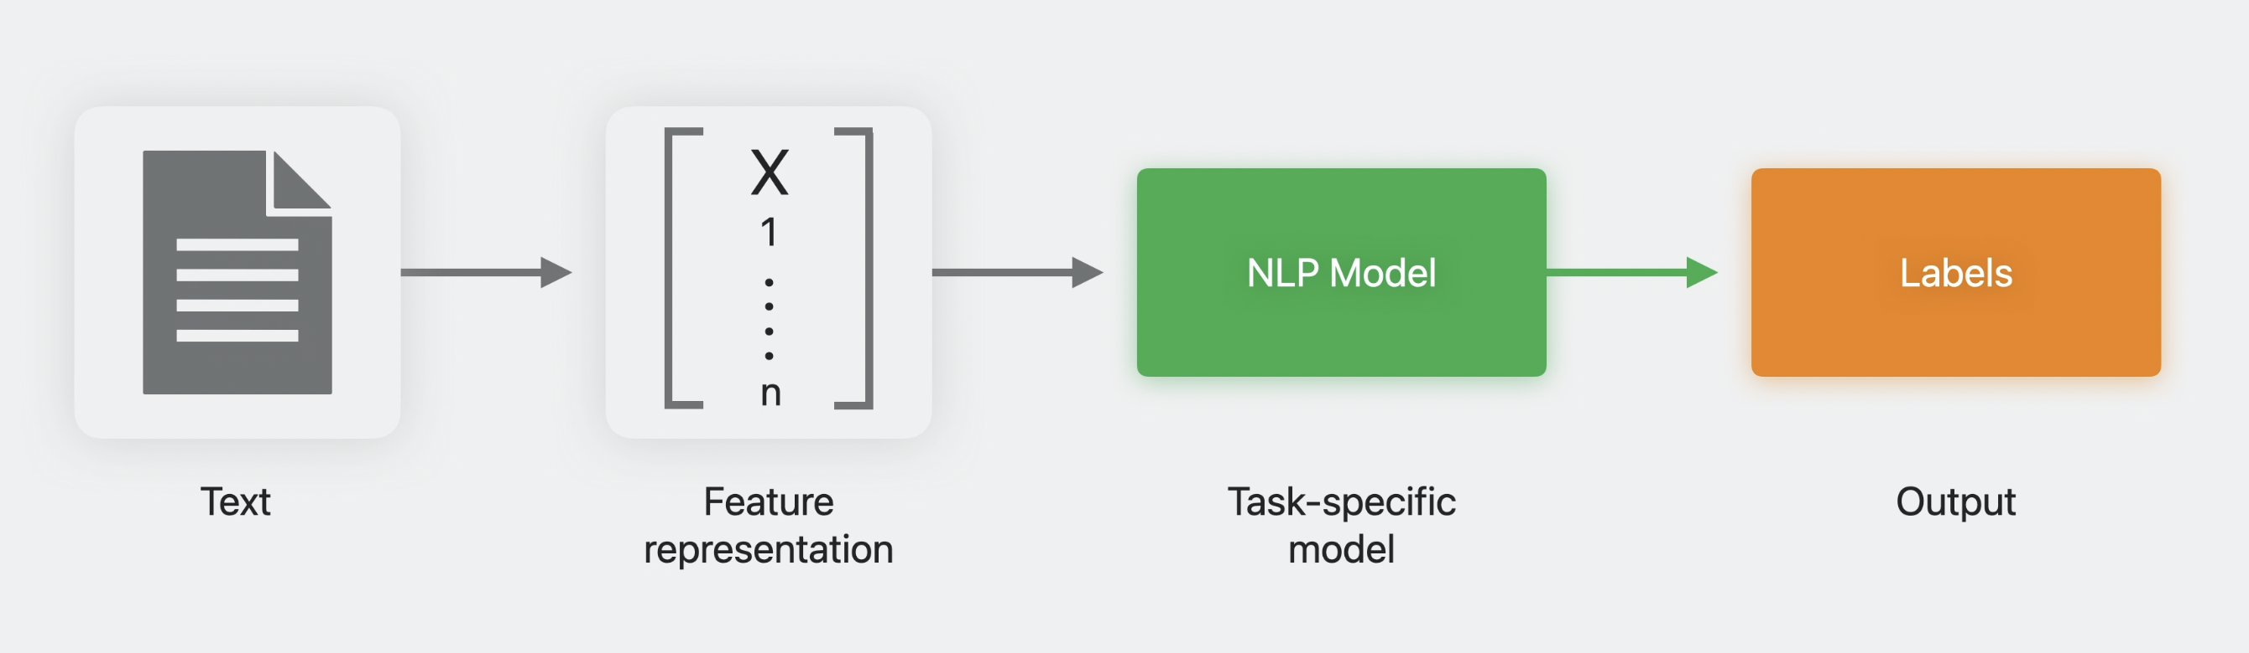
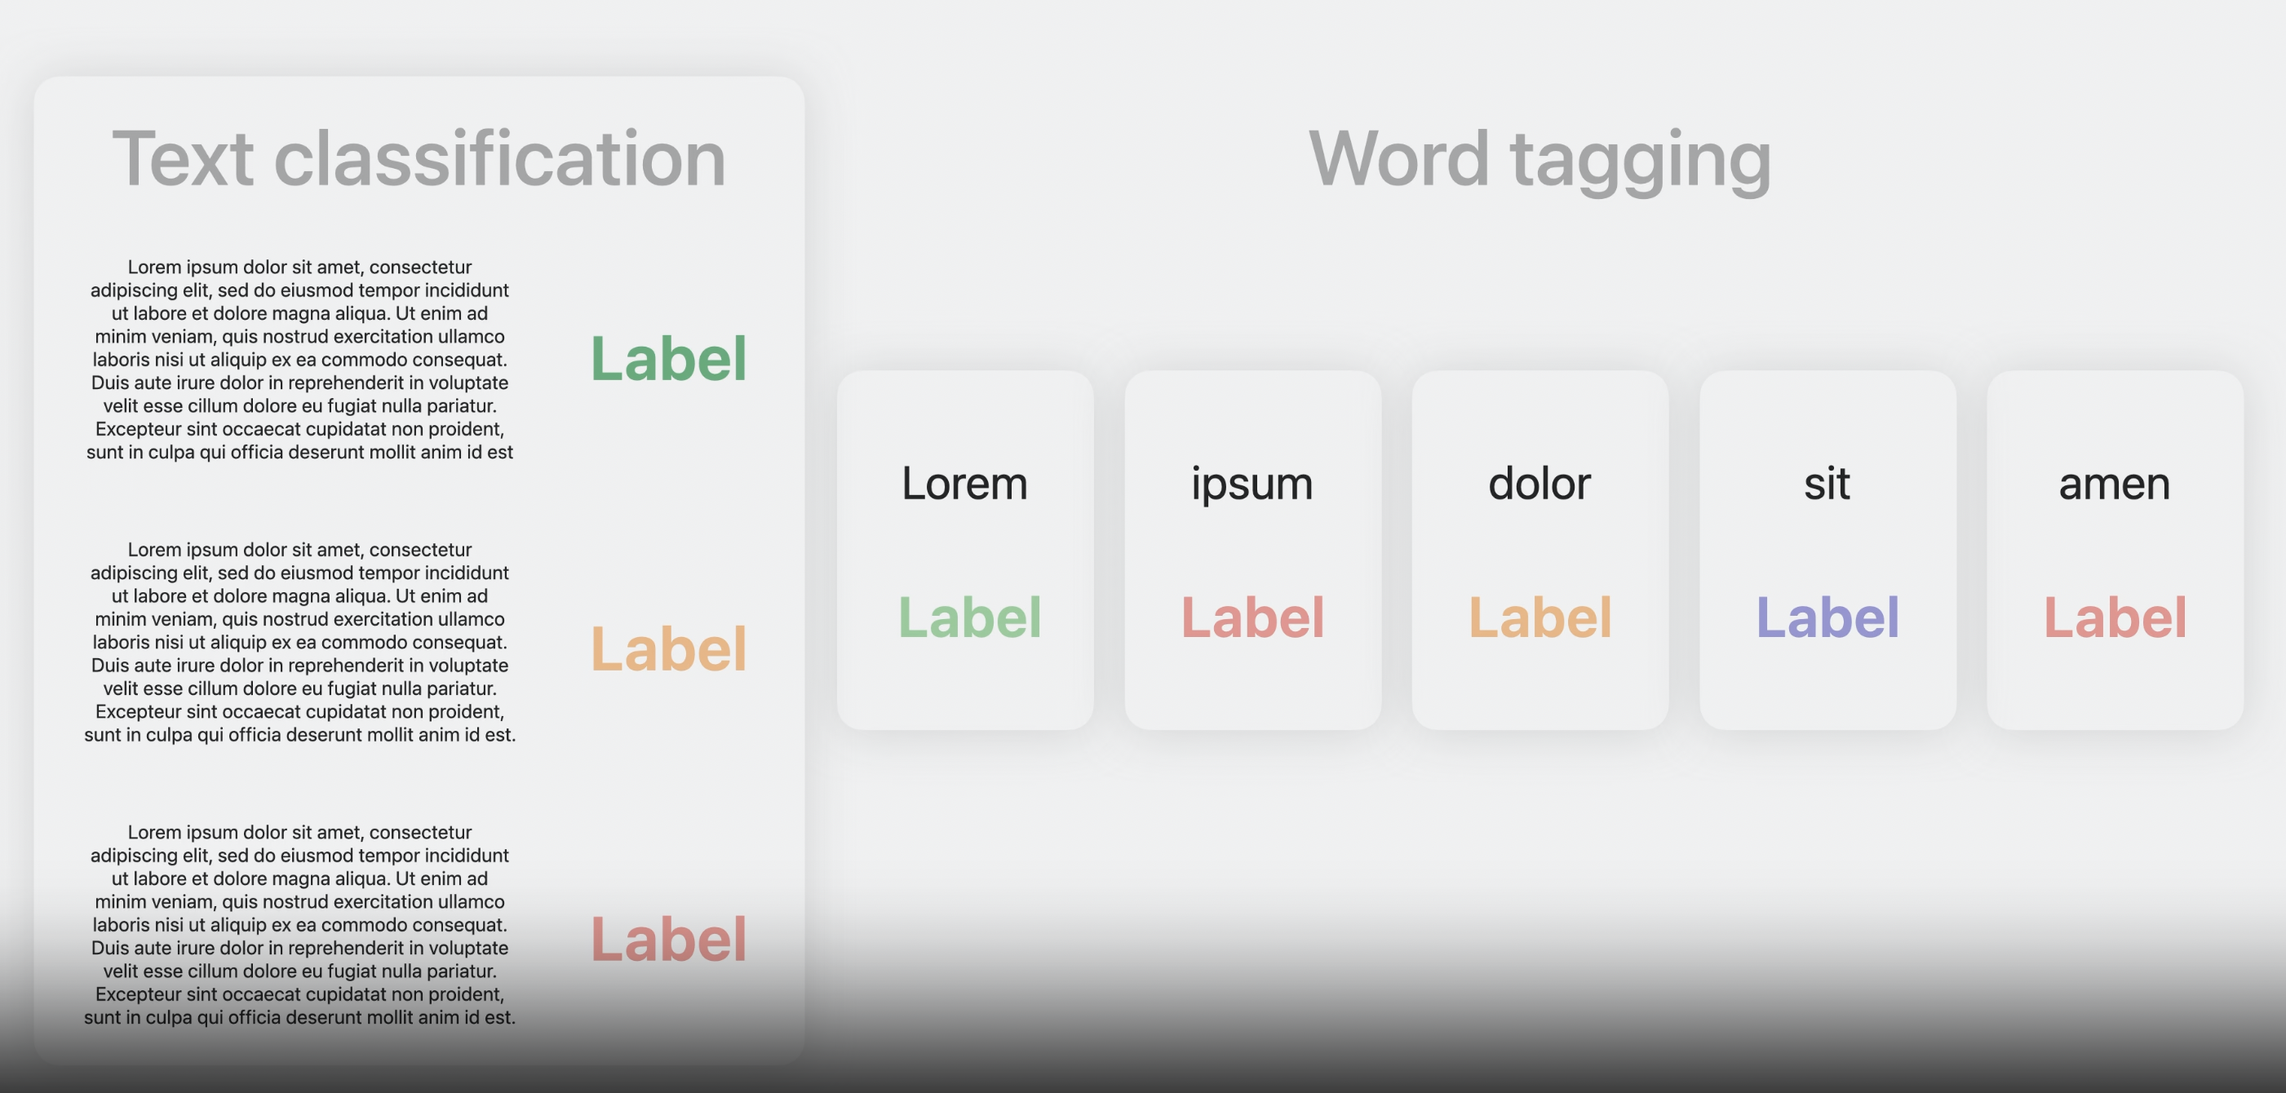
Custom Models
Domain specific or addressing unique requirements
UseCases:
Custom sentiment analysis
Automated support ticket classification
Automated content moderation
Domain specific NER
Notes:
Custom Sentiment Analysis: Develop a sentiment analysis model tailored to specific domains or industries, such as finance, healthcare, or retail, to accurately understand the opinions and feelings expressed in user-generated content.
Domain-Specific Named Entity Recognition (NER): Create a custom NER model to identify and tag entities specific to a certain domain, like medical terminologies, legal definitions, or industry-specific jargon.
Automated Support Ticket Classification: Build an NLP model to automatically classify and route support tickets based on their content and urgency, helping businesses shorten response times and ensure customer satisfaction.
Develop a custom model capable of automatically analyzing and moderating user-submitted content on a website, ensuring that inappropriate, offensive, or spammy content is removed or flagged.

Slide 16
Creating custom NLP model
Notes:
Using CreateML in playground and createML
Converting using CoreML tools

Slide 17
ML for Apple platforms
Notes:
Three primary ways we can get started with ML in apple platform.
Turi Create:
It is an open source project with a python interface.
It does require setting up pip, virtual environments and a python configuration
It simplifies the development of custom machine learning models by re-training facility. You don't have to be a machine learning expert to add recommendations, object detection, image classification, image similarity or activity classification to your app.
Create ML:
It is a swift framework and a MacOS application
It requires at least MacOS Catalina and Xcode 11
Core ML tools:
It is a python package to convert models from third party training libraries such as tensorflow, keras, caffe, etc to CoreML
It also helps to Read, write, and optimize Core ML models.
It requires you to train the model externally and convert it to run on your device

Slide 18
Demo - Creating a custom NLP Model using CreateML
Notes:
Precision and recall are performance metrics used for pattern recognition and classification in machine learning.
Some of the models in machine learning require more precision and some model requires more recall. So, it is important to know the balance between Precision and recall or, simply, precision-recall trade-off.
True Positive: This combination tells us how many times a model correctly classifies a positive sample as Positive?
False Negative: This combination tells us how many times a model incorrectly classifies a positive sample as Negative?
False Positive: This combination tells us how many times a model incorrectly classifies a negative sample as Positive?
True Negative: This combination tells us how many times a model correctly classifies a negative sample as Negative?
The output is size is so small because all the intense modeling happens back at Apple and only the last layer implementation happens in the create ml Appl.
Transfer learning models use a pre-trained model as a feature extractor, you specify the MLTextClassifier.FeatureExtractorType. Transfer learning models can take longer to train, but can improve accuracy because the baseline model has already been trained on a large amount of text in a specific language.
Feature Extractor Types:
.staticEmbedding - built in word embedding
.dynamicEmbedding - word embedding based on their in-contextual use
.elmoEmbedding - Elmo word vectors are computed on top of two-layer bi-directional model(biLm)
.bertEmbedding - Bi-directional Encoder Representations from Transformers from Google AI team. It introduced Transformers which a popular attention model into natural language modelling
As opposed to directional models, which read the text input sequentially (left-to-right or right-to-left), the Transformer encoder reads the entire sequence of words at once. Therefore it is considered bidirectional, though it would be more accurate to say that it’s non-directional. This characteristic allows the model to learn the context of a word based on all of its surroundings (left and right of the word).

Slide 19
Demo - Converting a Pre-Trained model using CoreML tools
Notes:
Facebook Bert to ONNX model
ONNX - Open Neural Network Exchange, it is an eco-system of technologies companies and research organisations (like Facebook, Microsoft, IBM, Intel, AMD, Qualcomm etc) that establish open standards for representing ML algorithms
Onnx model to CoreML model

Slide 20
Integrating ML Model into our app

Slide 21
Demo - Integrating Classification model in our app

Slide 22
Demo - Integrating On-Device Embedding Intelligence in our app

Slide 23
What’s new in WWDC 2023?
Natural Language multi-lingual models (BERT)
Advances in Transfer Learning
Enhanced Pre-trained models
Optimisation and Compression of custom models
Async predictions
Addition to ANE & UpdatableModel supported layers
Notes:
Advances in Transfer Learning: Improved methodologies for fine-tuning pretrained models on domain-specific tasks or unique user requirements, making custom NLP models more efficient and adaptive.
Enhanced Pretrained Models: Better performance and efficiency of pretrained models like BERT and GPT, possibly making them lighter and more suitable for on-device implementations.

Slide 24
Conclusion
ML Model Creation & Customisation
ML Model Integration & Prediction
Multi-Lingual support
Task/Domain specific refined small custom models
Transfer learning from pre-trained LLMs
Notes:
Machine learning in mobile apps has a lot of scope, and irrespective of the platforms like Android or iOS, It helps in understanding the user behavior better and maintaining their engagement effectively. Today, ML-based apps have started showing their impact in the way we work and live.
Machine Learning also helps in making apps more secure and user-friendly.
We can certainly expect that more business and enterprise apps will come with ML functionality in the future
LLaMA - 7B to 65B parameters
Google gemini
ChatGPT
More adaption to task specific pre-trained models

Slide 25
Resources
WWDC videos
https://developer.apple.com/machine-learning
https://machinethink.net/blog - machine learning and AI blogs by Matthijs Hollemans
https://github.com/likedan/Awesome-CoreML-Models - collection of machine learning models in Core ML format

Slide 26

Thank You!
Any Questions?

